Slide 1
AI STUDY ASSISTANT
NAME - SANDEEP KUMAR VERAM
COURSE- Artificial Intelligence Final Project
SDG: SDG 4 – Quality Education

Slide 2
Table of contents
01
02
03
04
05
06
OBJECTIVE
PROPOSED METHODOLOGY
DATA FLOW DIAGRAM
TECHNOLOGY STACK & LINKS
EXPECTED OUTCOME
CONCLUSION AND FUTURE SCOPE
07
SCREENSHOTS

Slide 3
OBJECTIVE
Develop an AI-powered study assistant chatbot.
Answer students' academic questions instantly.
Provide study materials and learning resources.
Assist with exam preparation and revision.
Offer programming and career guidance.
Support 24/7 learning assistance.
Promote quality education through AI (SDG 4).
Provide a simple and user-friendly interface.

Slide 4
PROPOSED METHODOLOGY
Collect user queries through the chatbot interface.
Process the queries using an AI model (Gemini/OpenAI).
Generate accurate and relevant responses.
Provide study materials, guidance, and learning resources.
Display the response and improve the chatbot based on user feedback.

Slide 5
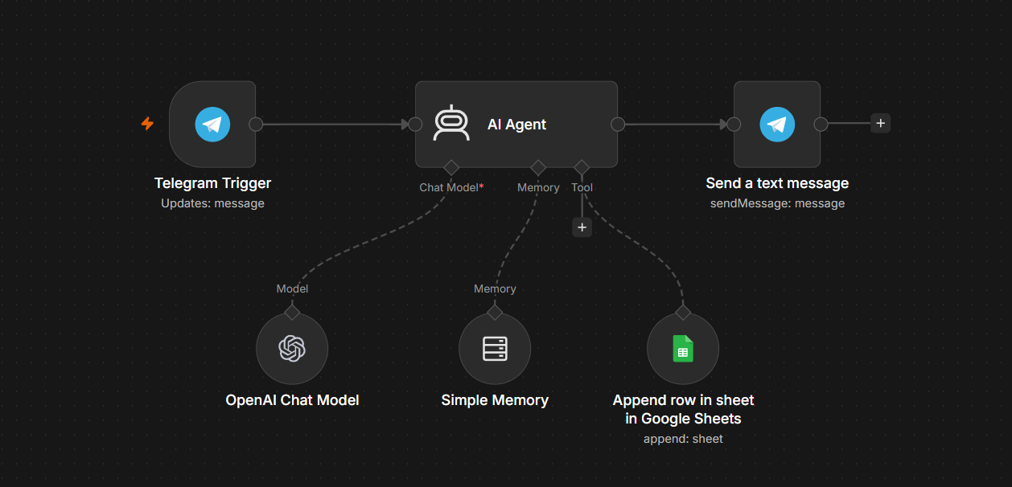
DATA FLOW DIAGRAM

Slide 6
TECHNOLOGY STACK & LINK
Workflow Automation: n8n
AI Model: OpenAI API
Programming Language: JavaScript (n8n Function Nodes)
API Integration: HTTP Request Node
Version Control: GitHub
Documentation: Microsoft Word / PDF
Development Environment: n8n Cloud / Local n8n
TELEGRAM LINK : https://t.me/AI_STUDY_ASSISTANT89_bot
GITHUB LINK: https://github.com/sandy777732/AI-Study-Assistant.git

Slide 7
EXPECTED OUTCOME
Develop a functional AI Study Assistant chatbot.
Provide quick and accurate responses to student queries.
Improve access to quality study materials and learning resources.
Enhance students' learning experience through AI assistance.
Support exam preparation with useful tips and guidance.
Offer basic programming and technical support.
Provide career guidance and skill development recommendations.
Enable 24/7 academic assistance for students.
Create an easy-to-use and interactive chatbot interface.

Slide 8
CONCLUSION AND FUTURE SCOP
Conclusion
The AI Study Assistant is an AI-powered chatbot that helps students with study materials, exam preparation, programming support, and career guidance. It provides quick and reliable academic assistance, promotes self-learning, and supports SDG 4 – Quality Education by making learning more accessible
Add voice-based interaction.
Support multiple languages.
Develop a mobile application.
Provide personalized learning recommendations.
Integrate with Learning Management Systems (LMS).
Improve accuracy using advanced AI models.
Future Scope

Slide 9
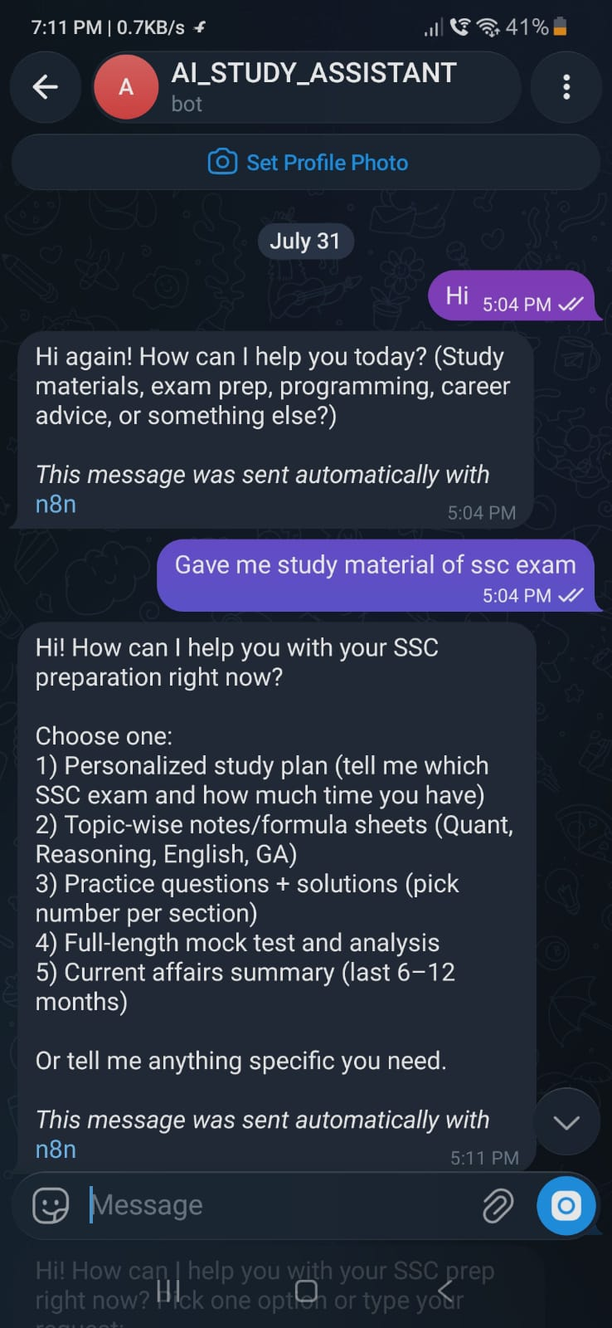
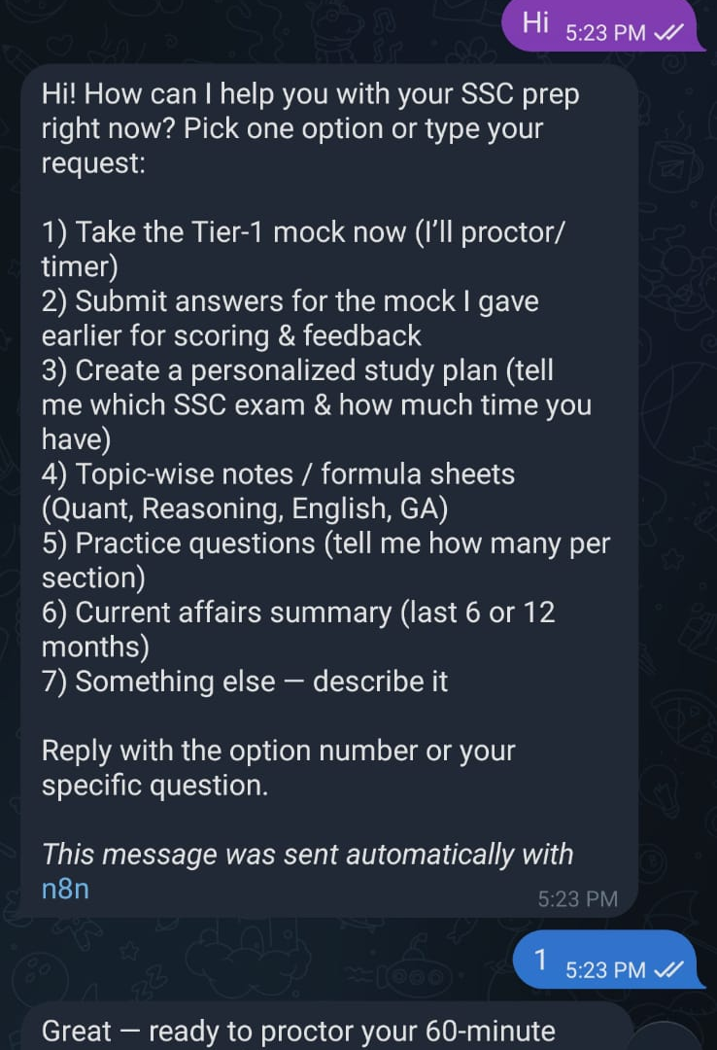
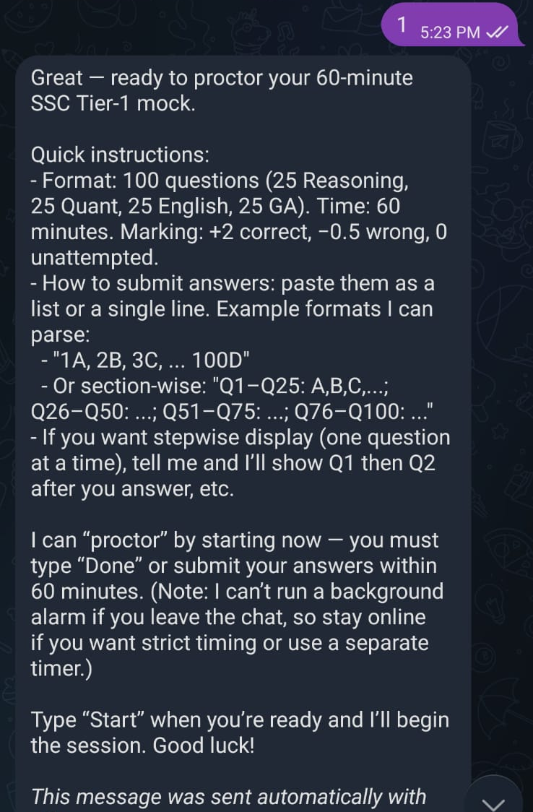
SCREENSHOTS

Slide 10
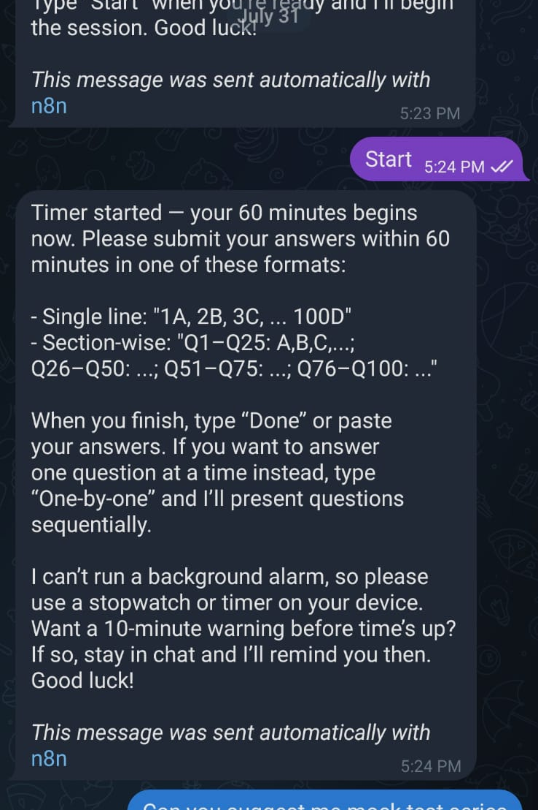
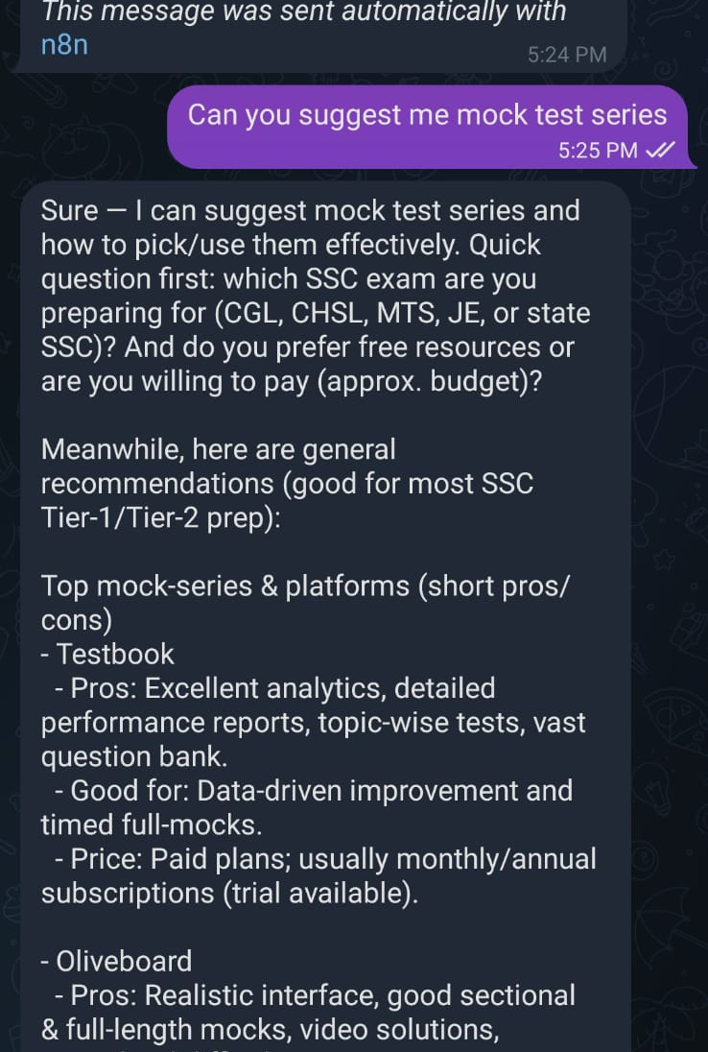
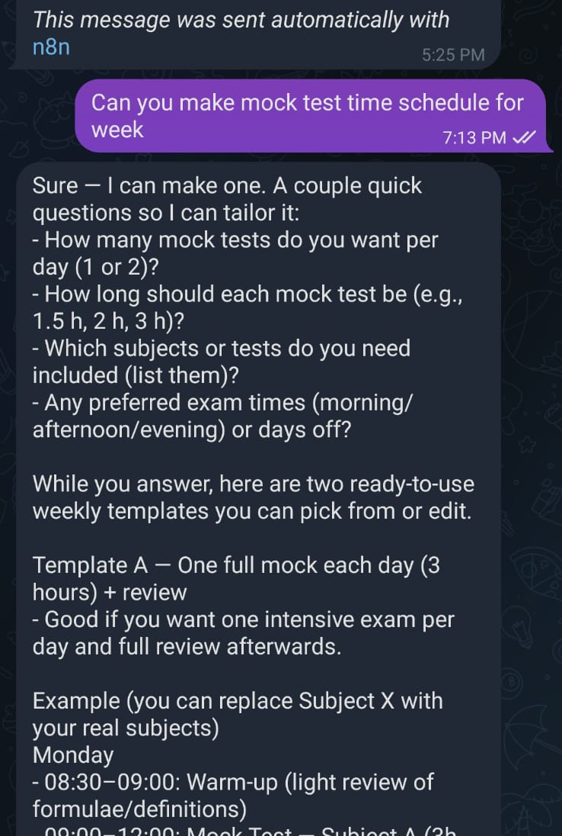
SCREENSHOTS

Slide 11
THANK YOU

